Slide 1

Final Capstone Medical Insurance Cost Analysis
Brock Franz
Notes:
Good morning, my name is Brock Franz and I’m a data analyst from Gilbert AZ.
Im here today to present my statistical research and findings from a dataset I obtained
A little bit about me, I have been analyzing data in different ways for 15 years now. I recently graduated from Thinkful university where I did a deep dive study into Excel, SQL, Tableau, Powerpoint and Python to better my skills in interpreting and presenting data based information.

Slide 2

Objective
To analyze a given dataset and observe any statistical significances
Use Python to analyze, organize, and visualize data
Make final recommendations and observances to give to the end user
Dataset provided by Kaggle (Link Below)
Notes:
The objective of this exercise was to find a dataset and conduct statistical analysis in python and make observations to be given to an end user
I found a dataset on Kaggle ( the link is provided below) that provided statistics on medical insurance costs that seemed interesting and started my analysis

Slide 3

Analyze the Data
There are 7 columns in this dataset that include 1338 rows giving variables for:
Age
Sex
BMI
Number of Children
Smoker
Region located
Insurance charges annually
The basics
Import pandas and other programs
Load data into a colab notebook
Call statistical data from each column
Notes:
To begin I loaded the dataset into a colab notebook and imported all of the programs I would be using for this research
Basic analysis showed the dataset contains 7 columns and 1338 rows of categorial and continuous variables.
The columns provided were age, sex, body mass index, number of children the participant has, if they are a smoker or not,what region they are located in, and the annual insurance charges they incurred

Slide 4
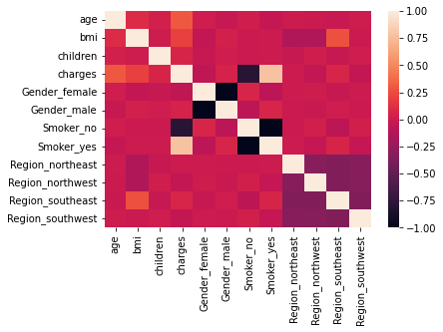
Statistical Data
Create a “dummy” data to divide categorical columns in to separate entities
Gender into 2 groups
Smokers into 2 groups
Region into 4 groups
Run correlation model and display in heatmap
The closer the correlation is to number one, the higher the likely the variables have a direct relationship.
Smoking and BMI each have a clear correlation with charges
Notes:
To break the data down into separate pieces for easier analysis, I created a dummy data set and split the categorical data into separate columns. The data set now contained 12 columns in total.
I ran a correlation model on the new “dummy” dataset and created a heatmap to visualize which variables held stronger relationships with each other, the closer the correlation coefficient is to 1 or -1, the closer the relationship between the 2 variables
As we can see, smoking and BMI seem to go hand in hand with charges

Slide 5

Hypothesis #1
Do smokers incur more medical charges than non smokers?
H_{o}= There is no significant difference in medical cost between smokers and non smokers.
H_{a}= There is a significant difference in medical costs between smokers and non smokers.
Notes:
This leads us to the first null hypothesis.
There is no significant difference in medical cost between smokers and non smokers.
In turn, the alternative hypothesis would be that there is a significant difference in medical costs between smokers and non smokers

Slide 6
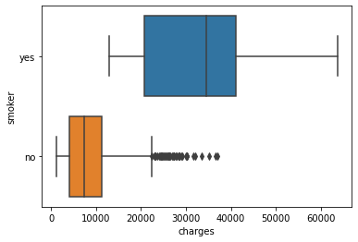
Statistical Testing
Boxplot shows a significant variance between smokers and non smokers
Pearson Correlation test shows a correlation coefficient of .787 and a p value of p<.005 between smoking and charges.
High correlation and extremely low p-value assume statistical significance
stats.pearsonr(dummy['Smoker_yes'], dummy['charges’])
(0.7872514304984775, 8.271435842176839e-283)
Notes:
Statistcal testing began
I created a boxplot to show where the mean charges fell within the sample populations of both smokers and non smokers
The chart shows a significant variance as smokers seem to incur more insurance charges
Next I ran a Pearson correlation test between “smokers” and charges
It retuned a very high correlation coefficient of 0.787 and a very small p value of less than 5/1000s
These results assume statistical significance, but we can dig a little deeper

Slide 7
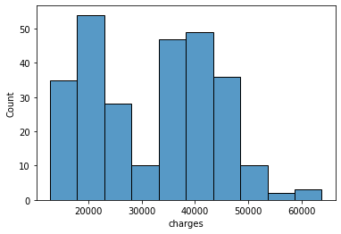
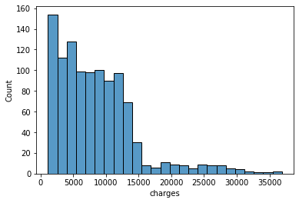
Testing Continued
Run a T-test assuming unequal variances on charges of smokers vs non-smokers
T-test shows a standard deviation of 32.75 between the 2 samples with a very small p-value at p<.005
Histograms show smokers charges are spread more evenly across the x-axis while non smokers are skewed left.
The difference in means at the 95% confidence interval is between 25026.77764671189 and 22205.14942064140
Notes:
Next I ran a T test assuming unequal variances with the charges of smokers vs non smokers
The test revealed a standard deviation of 32.75 with again a p-value of less than 5/1000s
For visual reference I created a histogram for each group to see the spread of charges.
Final statistical analysis showed difference in means at the 95% confidence interval is between 25,026 and 22,205

Slide 8
Reject the Null
Reject the null hypothesis with a 95% confidence interval as the difference in means is between 25026.777 and 22205.149
We can see from the statistical data and testing that there is a significant relationship with smoking and higher insurance charges.
Notes:
With all of these tests completed we can absolutely Reject the null hypothesis as there is clearly significant difference in medical cost between smokers and non smokers.

Slide 9

Hypothesis #2
Does higher BMI correlate to higher medical charges?
Ho= There is not a correlation between medical costs and BMI
Ha= There is a correlation between medical costs and BMI
Notes:
Now on to the 2nd null hypothesis
There is not a correlation between medical costs and BMI
The alternative being that there is a correlation between the 2

Slide 10
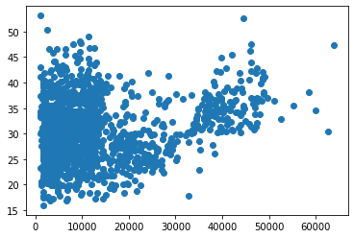
Statistical Testing
Create scatterplot to visualize charges vs BMI
Conduct Pearson correlation test
Analysis shows a correlation coefficient of .198 and a p-value of p>.005 between BMI and charges
stats.pearsonr(dummy['bmi'], dummy['charges’])
(0.1983409688336288, 2.459085535117846e-13)
Notes:
To analyze this theory I created a scatterplot chart to look at the distribution of charges compared to body mass index
Next I ran a Pearson correlation test to look for correlation between the 2
At a coefficient of 0.198 and a p value less than 5/1000, there is a very weak positive correlation

Slide 11
Reject the Null
Reject the null hypothesis as there is very weak positive correlation between BMI and charges at a 0.198 correlation coefficient
Notes:
With these simple tests we can reject the null hypothesis, while it is very weak, there is a minor correlation between BMI and charges

Slide 12

Summaries
There is significant difference in medical charges between smokers and non smokers.
While this outcome may not be a surprise to many, smoking is directly linked to higher insurance charges.
This information would be a great tool in either anti-smoking campaigns or advertising for smoking cessation companies.
Further research could easily be extended into other avenues such as connections between smoking and the specific charges and medical conditions that are being charged.
Notes:
In summary, smoking is bad for you.
This may not be a surprise to many, but smoking is linked to higher insurance charges.
This statistical data would be a valuable tool for smoking cessation companies or anti-smoking campaigns.
This research could absolutely be continued on and dive deeper into the specifics of the insurance charges and exactly what medical conditions are arising due to smoking.

Slide 13
Summaries
While there is a small correlation between BMI and medical charges, it is very weak.
This research could be used by health professionals, personal trainers, and dieticians to help convince people to stay healthy, make better choices, and exercise regularly.
While the relationship between BMI and insurance charges is very small, it is still statistically relevant.
It would be interesting to follow this research more in depth to get other variables such as life span, dietary regiments, and overall health statistics to make the research more robust and dive further into the relationships.
Notes:
Lastly, Body Mass Index does not play as big of a part in medical charges as I had thought going into this. A weak correlation was shown but is still statistically relevant
This research would be beneficial to health professionals, personal trainers, or dieticians to help convince people to stay healthier, make better choices, and exercise regularly to maintain a healthy lifestyle
The analysis could continue into other variables such as life span, dietary regiments, and overall health statistics to create a more robust visual of the topic.

Slide 14

Thank you for your time and attention,
Questions?
Brock Franz
Notes:
At this time I want to thank you for your time and attention.
Any questions?

